Slide 1

East Ottawa Girls Hockey Association
Annual General Meeting
November 4th, 2024

Slide 2
Motion to approve the appointment of Rick Leach as chairman of the AGM
Notes:
According to the current Bylaws article 10.07, the chairman of the AGM is to be the corporation's president. However, for this years AGM it would be best that a non member be allowed to oversee the AGM to ensure the order is kept and an efficient AGM is carried out. The member being proposed is the past-president of the GCGH and is selected due to their knowledge, understanding and proceedings of the corporation.

Slide 3
REMINDER: Code of Conduct
OWHA Code of Conduct
This Code of Conduct identifies the standard of behaviour which is expected of all Ontario Women's Hockey Association (OWHA) Members, including athletes, coaches, parents, directors, volunteers, staff, chaperones and others. OWHA Teams, Associations, Programmes and Leagues are committed to providing a sports environment in which all individuals are treated with respect. Members of the OWHA shall conduct themselves at all times in a fair and responsible manner.
Members shall refrain from comments or behaviours which are disrespectful, offensive, abusive, racist or sexist. In particular, behaviour which constitutes harassment, abuse, bullying or cyberbullying will not be tolerated by the OWHA.
Failure to comply with this Code of Conduct may result in disciplinary action, suspension or release from membership. Such action may result in the member losing the privileges that come with membership in the OWHA, including the opportunity to participate in OWHA activities and events both present and future.
GCGH Code of Conduct
(56) The GCGH is committed to providing and maintaining an athlete-centered girls hockey environment where all individuals are treated with respect. During the course of all GCGH activities and events, members of GCGH will conduct themselves at all times in a fair and responsible manner. They are expected to refrain from comments or actions that are disrespectful, offensive, abusive, racist, or sexist.
(57) Members will avoid behaviour that brings the GCGH or the sport of hockey into disrepute, including but not limited to abusive use of alcohol and non-medicinal use of drugs, or that endangers the safety of others.
(58) Failure to comply with this Code of Conduct will result in disciplinary action in accordance with GCGH Team/Association Discipline Policy.

Slide 4
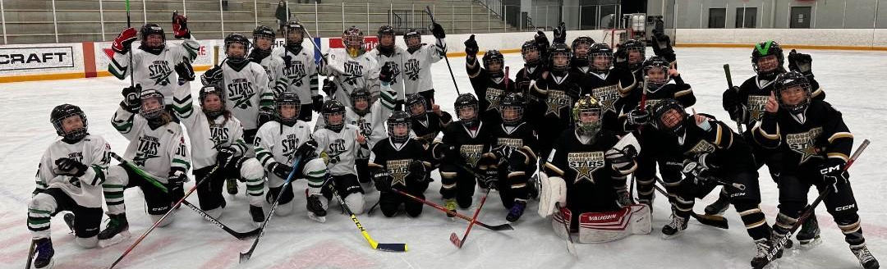
GCGH
Mission Statement
To provide girls the opportunity to play hockey at the elite or recreational level in a fun, healthy and safe environment that develops life skills that will last beyond hockey.

Slide 5
AGM Agenda
Call to order
Approval of agenda
Approval of the Sept 26. 2023 minutes
Opening remarks
Presentations from the board members on the 2024/25 season
Review of financial statements
Changes to bylaws
Voting on 2024/25 board positions
Other business
Closing remarks
Adjournment

Slide 6
Motion to approve the GCGH Association Annual General Meeting Agenda for 2024
Motion to approve the Minutes of the 2023 Annual General Meeting

Slide 7

Opening Remarks
Here are some key achievements for EO & GCGH this past season:
  Through the First Shift and Learn to Play Programs we were able to introduce hockey to approximately 90 new girls in Ottawa who otherwise would not have been able to play. Utilized Big Kruger Assist funds of $25,000 to support this and other initiatives.
  Continued to support the growth of women in hockey.
    GCGH hosted the “WE ARE COACHES” program - enabling our female coaches and future coaches access to free training to obtain their Dev 1 Certification.
    Our Learn to Play program was entirely staffed by female coaches and on-ice helpers.
  Another record year in terms of revenues and registration as well as icing the most teams in GCGH history.
  Focus on development to ensure our players have the best development experience in Ottawa.
  Reduce costs- GCGH reimbursed each team for one hockey tournament last season to help teams reduce team fees.
  Rolled out the new uniforms/brand for the rest of the competitive teams for the 24/25 season.
  Had a legal review done on our Bylaws to ensure that they were in compliance with the act. Approving at this meeting.
In 2024/25 our goal remains to be the best place for girls to play hockey in the Ottawa area. To achieve this, we will continue to focus on player development, provide financial relief for our members, and attract new girls to the game through First Shift and our Learn to Play program.

Slide 8

ANNUAL REPORT – COMPETITIVE
2023-24 - Levels and Coaches:
GCGH/EO Competitive programming iced 20 teams last season.
U9B – Randy Dagenais U11C – James Ostrom U11B – Colleen Kenny U11 BB – Melissa Simard* U11AA – Grayson Lafoley U13A –Kevin Kitchen U13B – Chris Sideroff U13C – Elias Argibay U13 AA – Jeff Dunbrack U15C - Robert Amos U15B - Brian Alonzo | U15BB - Jessica Wilson U15AA - Matt Ouellette U15A - Dan Savage U18AA - Matt O'Connor U18A - Casey Scobie U18BB - Luc Nadon U18BB - Ryan O'Donnell U18B - John Bower U18C - Brian Harrington U22AA - Dan Tessier* Senior A - Al Julien* Senior C - Barry Prieur *Non Parent HC

Slide 9
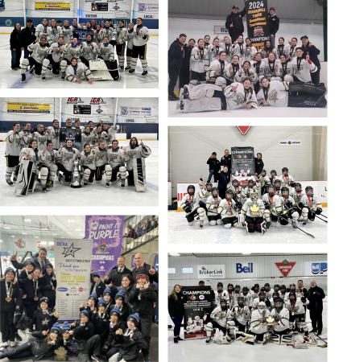

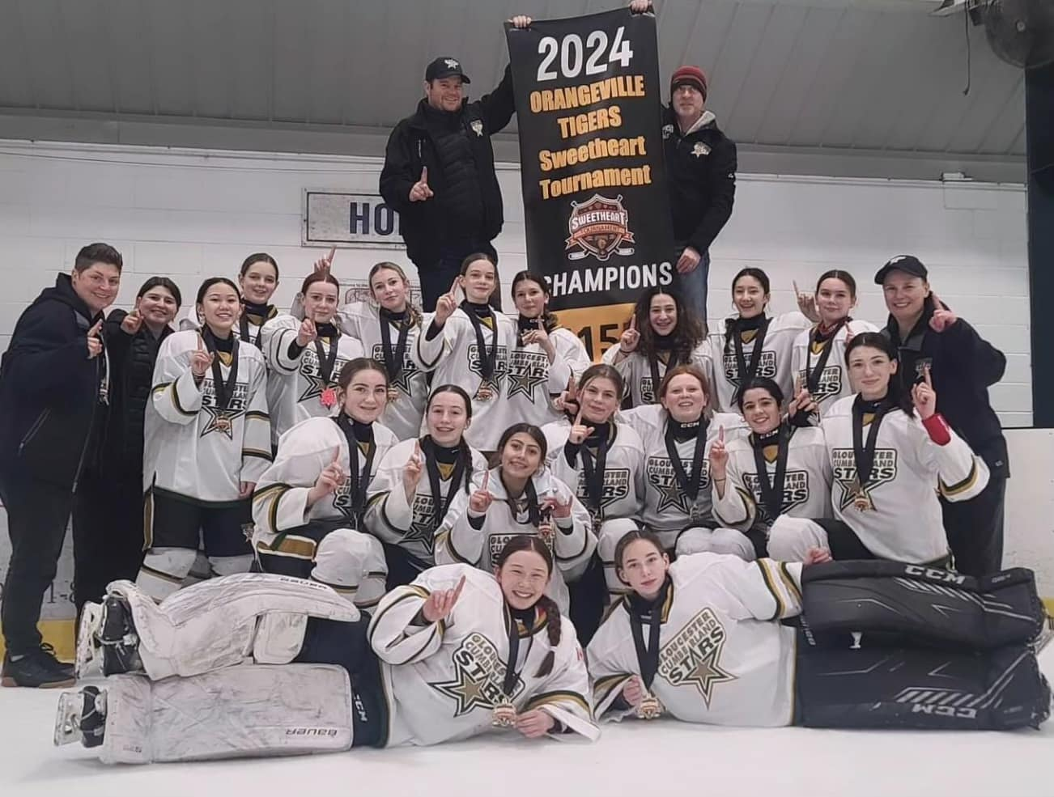




ACCOMPLISHMENTS COMPETITIVE
Tournament Gold Medals:
U11BB- GCGH Tournament
U15BB - Orangeville Tournament
U18A, U15A- Tournoi provincial hockey féminin de sherbrooke
U11AA - Nepean DFID
U18BB, U18C - Kanata Tournament
U18C, U18BB- Pink the Rink
U18B - Smith Falls Clubtown Tournament
U11B - Clarington Applefest Tournament

Slide 10

ACCOMPLISHMENTS – COMPETITIVE
OWHL Eastern Championships
League Champions - U15AA, U11AA, U15C, and U18C
Provincials
10 Teams were invited to Provincials (Due to exam schedules both Senior teams were unable to attend)
U18BB - Bronze
U11BB, U11AA, U13AA, U15AA, U18C, U15BB and U9B

Slide 11
ANNUAL REPORT – COMPETITIVE
2024-25 - Levels and Coaches:
The EO competitive program has iced 21 teams this season
U9B – Randy Dagenais U11C – Jeff Leech U11B – Karl Giguère U11 BB – Colleen Kenny U11AA – Alli Monuk* U13A –Bob Hocquard U13BB - Mark Harding U13B – Elias Argibay U13C – Dave Steen U13 AA – Emma Shimizu* U15C - Stephen George/ Mike Washburn U15C - Paul Blahey *Non-parent HC | U15B - Meghan Lalonde* U15BB - Jessica Wilson U15AA - Jeff Dunbrack U15A - Todd Houston U18AA - Pat Hogue U18A - John Giannitsopoulos* U18BB - Luc Nadon U18BB - Geneviève Leroux Stéphane Bond U18B - Dan Payer U18B - Bob Sauve U22 - Dan Tessier Senior A - Al Julien Senior C - Barry Prieur

Slide 12

ANNUAL REPORT – HOUSE LEAGUE
2023-24 we had 13 teams from Fundamentals to U18
2024-25 we currently have 18 teams from Fundamentals to U18
That is a growth of 5 teams at the House League level
Fundamentals went from 46 players last year to 55 players this year
Teams are playing regular season in MOGHL with Ottawa, Rockland & AHFVG (Gatineau)
During sort outs, we offered “try goalie” sessions which didn’t yield any permanent goalies but allowed goalies to get a more comfortable feeling being in the net and has turned a few into 50% goalies.
We plan to offer association-wide Development for the House League level for Skaters and Goalies
We will plan to put together 4 DS team depending on player interest at the following levels: U11/U13/U15/U18

Slide 13
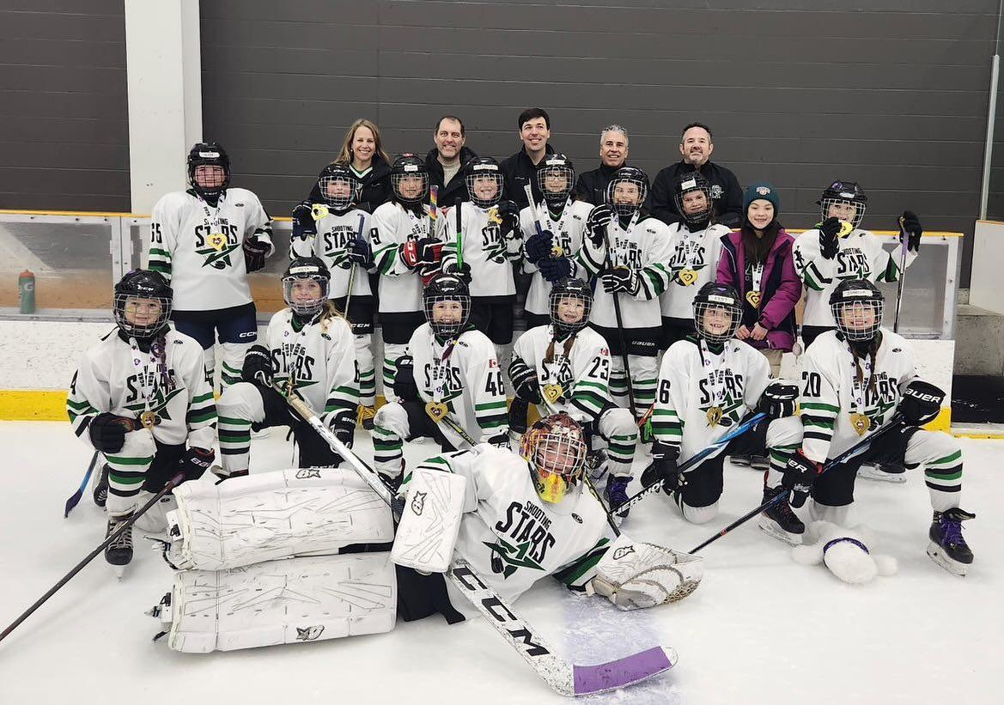
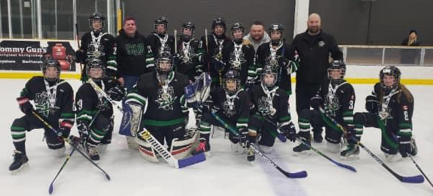
ANNUAL REPORT – HOUSE LEAGUE
2023-24 - Levels and Coaches:
FUNdamentals (U7) - Jeff Dunlop
U9 - Dan Bélanger, Jamie Janes, Patricia Toomey
U11 - Kevin Hurtubise, Pat Thompson
U13 - Mat Desjardins, Pat Lebrun
U15 - Kevin Hurtubise, Charles McIntyre, Marc Seguin
U18 - Bryan Bernard, Nick Cripps
13 house teams + 4 DS teams (coaches to be named)
Thank you to all of our coaches who dedicated their time to take on teams.

Slide 14
ANNUAL REPORT – HOUSE LEAGUE
2024-25 - Levels and Coaches:
U7 Fundamentals – Jeff Dunlop U9-1 Matt Corbeil U9-2 Francis Hamel U9-3 Jamie Janes U9-4 Chris Rowland U11-1 Patrick Gaudreau U11-2 Surby Herr U11-3 Charles Plante U13-1 Mathieu Desjardins U13-2 Laura Dill U13-3 Pat Thompson | U15-1 Darren Cousineau U15-2 Kevin Hurtubise U15-3 Ann Marie Wheeler U18-1 Scott Yates U18-2 Nick Cripps U18-3 Chris MacDonald U11-DS TBD U13-DS TBD U15-DS TBD U18-DS TBD

Slide 15

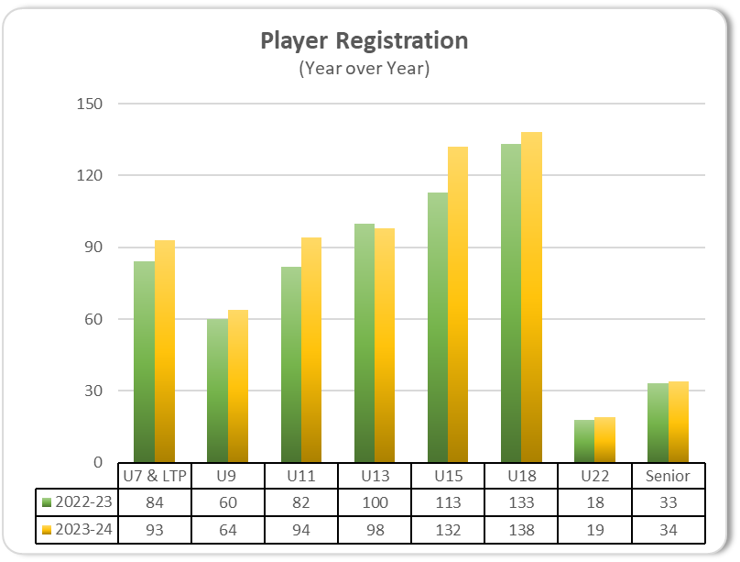
ANNUAL REPORT – Registration
Player Registration
We rostered 672 players in 2023-24
There was an 8% increase in player registrations for 2023-24 and trending towards 10% growth for 2024-25. Growth is primarily attributed to:
Limited opportunities and offerings at other local associations
Retention of First Shift and Learn to Play players
Retention and recruitment efforts
Ratio of Comp to House stayed relatively consistent.
Volunteers
Over 400 volunteers supported our teams in 2023-24
Increased the number of female staff on the bench; however growth is not keeping pace with overall volunteer growth rate.
*Numbers exclude First Shift program

Slide 16
ANNUAL REPORT – DEVELOPMENT
Player/Goalie Development 2023 - 2024
This past season, GCGH had Apex as dedicated development provider for junior comp levels.
There were also a number of subsidies provided to teams for their development.
Sr. Comp teams were given $2,000 (player) and $500 (Goalie) in subsidies for their development.
HL had a number of sessions organized for them as well as subsidies to their budgets.
Introduced the Try Goalie program

Slide 17
ANNUAL REPORT – DEVELOPMENT
Player/Goalie Development 2024 - 2025
GCGH will once again have development subsidies for both house and competitive levels.

Slide 18
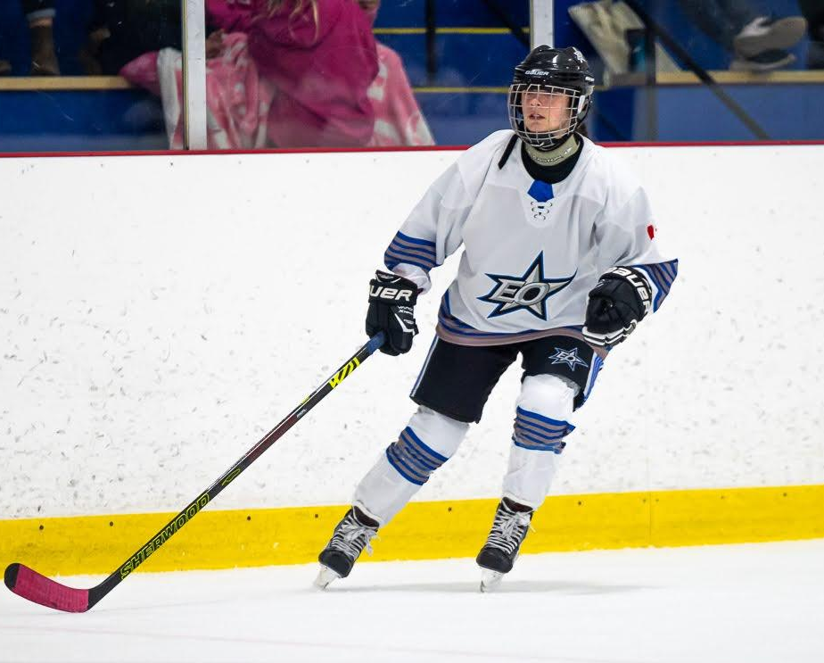
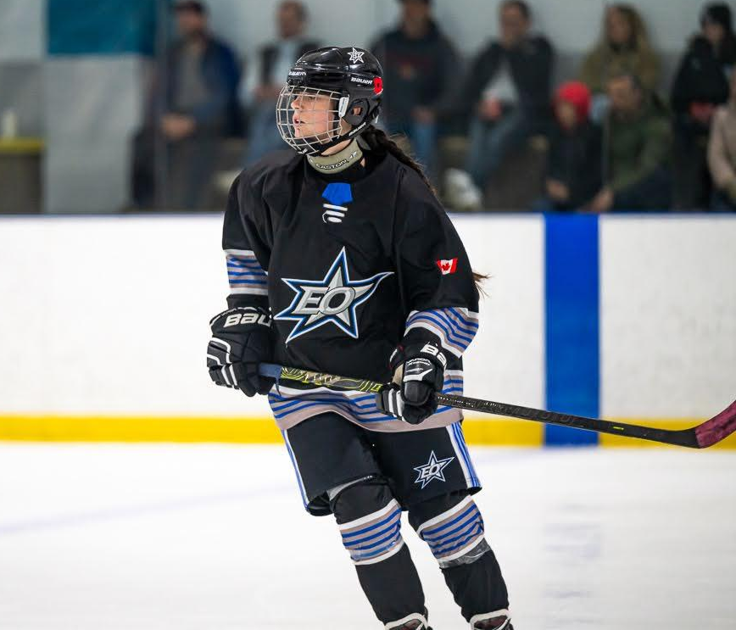

COMMUNICATIONS / MARKETING
Rebranding of Stars competitive program to align with EO AA brand completed.
Competitive teams all received new uniforms before start of 2024-25 season.
After comprehensive RFP process, official team apparel suppliers and team uniform suppliers were selected with a contract of three (3) years with two (2) option additional years were signed.
Association rebrand has been in progress since May with an anticipated timeline to finalize in January.

Slide 19
ANNUAL REPORT – DISCIPLINE & RISK
Throughout the 2023-2024 term, the discipline committee has increased communication and internal tracking of incidents to identify areas of improvement
All members are encouraged to review EOGHA and OWHA regulatory documents prior to starting your season with respect to risk and discipline
You can view all OWHA updates and bulletins as well as forms and policies at www.owha.on.ca and internal policies with respect to risk and discipline in the resources section of our website
Social Media awareness sessions in conjunction with Equity and Diversity have been conducted to reduce and prevent issues related to bullying, cyber bullying etc. Need will continue to be evaluated
If you have any questions, you can contact :Chelsey Burke riskdirector@gcgh.ca .

Slide 20
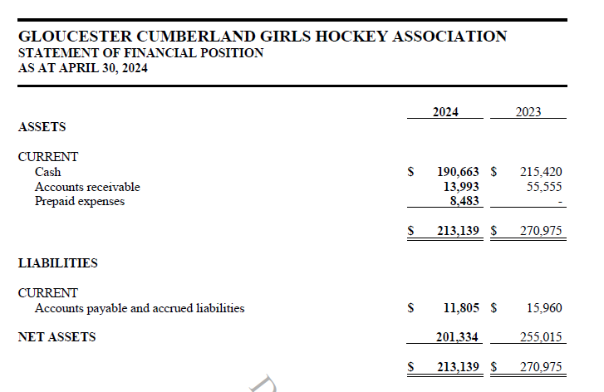
FINANCIAL STATEMENTS - Balance Sheet

Slide 21
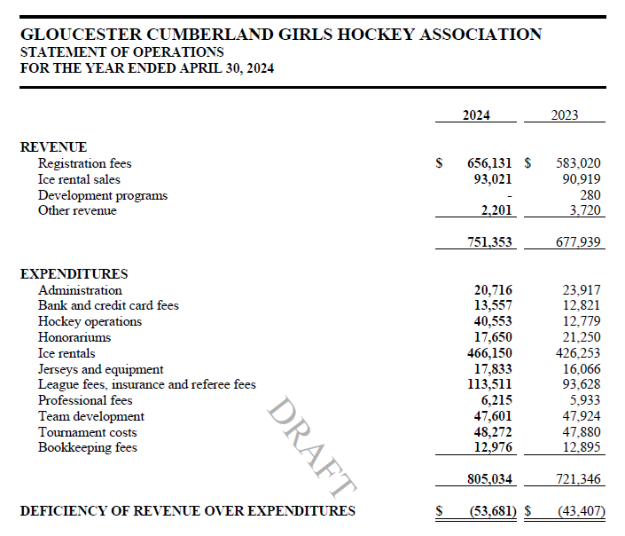
FINANCIAL STATEMENTS - Income Statement

Slide 22
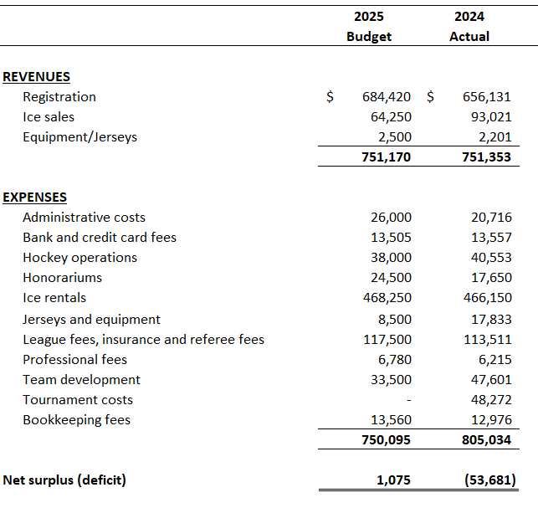
FINANCIAL BUDGET - 2024-25

Slide 23
Bylaws - Updates
Bylaws have been reviewed and updated to clarify some ambiguity.
The revised bylaws were circulated for review prior to this meeting
All bylaw changes would be in effect after the AGM if the motion is approved.
Key bylaw changes to be reviewed in subsequent slides.
Motion to approve bylaws as per notice.

Slide 24
Article 1 : Name of Association
Current: Gloucester-Cumberland Girls Hockey (GCGHA)
Proposed Change: East Ottawa Girls Hockey (EOGHA)
Notes:
This proposed additional wording is to clarify the article by providing an exact number of years a member may hold a position on the Board. In this article the ambiguity surrounds the word “re-election”, which by definition is the process of electing somebody again to the same position. Therefore, applying this definition to this article, an existing Director (that has served an initial term of two (2) years) may be re-elected for up to three (3) additional and consecutive two (2) year terms, for a total maximum term of eight (8) years. This has always been the intent of the by-law and the practice of the Association, having had members in the past holding a board position for a total of 8 years.

Slide 25
Article 4 : Ruling on Bylaws
Current: n/a
Proposed Change: Except as provided in the Act, the Board of directors of the Corporation (collectively, the “Board”, and individually, a “Director”) will have the authority to interpret any provision of these By-laws that is contradictory, ambiguous, or unclear, provided such interpretation is consistent with the Act and the Corporation's purposes and articles. For greater certainty, “By-laws” refers to this by-law and all other by-laws of the Corporation as amended and which are, from time to time, in force and effect.
Notes:
Article 5.01(a) provides that the Board shall annually or as often as may be required from among those individuals comprising the Board appoint officers, including a Fundraising and Sponsorship Director. As this role has never been filled since it was created, the Board is proposing that the Sponsorship duties be performed by the Communications and Marketing Director. Therefore, the Board is proposing this position be changed to Communications, Marketing and Sponsorship Director. As well, the Board is proposing that the current role of Inclusivity and Equality Director be renamed Equity, Diversity & Inclusion Director to more accurately reflect the position.

Slide 26
3.01 : Board of Directors
Current: The affairs of the Corporation shall be managed by a Board of Directors (herein referred to as the "Board") consisting of eighteen (18) Directors whom shall be elected, as hereinafter set out, together with the Past President of the Corporation.
Proposed Change: The Board will consist of up to nineteen (19) Directors who are elected, together with the Past President of the Corporation, in accordance with Section 3.03
Notes:
The proposal is to reduce the current number of Directors on the Board from 18 to 17. This is being proposed as many of the current Board positions have gone unfilled for many years and this improves the corporation's ability to have a full Board in the future. Furthermore, by having an uneven number of Directors, it reduces the possibility of stalemate votes as the quorum for a meeting will always be an uneven number.

Slide 27
3.02 : Qualification of Directors
Current: Directors shall be individuals, eighteen (18) or more years of age and shall, at the time of their election or within ten days thereafter and throughout the term of their office, be members of the Corporation
Proposed Change: Each Director shall :
(a) be an individual;
(b) be at least eighteen (18) of age and shall, ;
(c) at the time of their election or within ten (10) days thereafter be a Member of the Corporation;
(d) not have been found under the Substitute Decisions Act, 1992 or under the Mental Health Act to be incapable of managing property;
(e) not have been found to be incapable by any court in Canada or elsewhere; and
(f) not have the status of bankrupt.
Notes:
The proposed wording is being added to clarify the intent of the article, where the President is to be elected from within the current Board of Directors. By electing the President from the current Board of Directors, this ensures the continuity and vision that is required to guide the Corporation in the appropriate direction. This has been the standard practice for many years of the Corporation.
Nepean’s wording is similar to our, Kanata requires individuals to have previous experience on an executive hockey committee, OGHA picks the president from within the current board members. SInce 2010 no president took office except James Wotjck. There has been 7 presidents since.

Slide 28
3.03 : Election of Directors and Term of Office (d)
Current: From time to time in the event of any vacancy, be filled by the Directors from amongst the members of the Corporation; otherwise, vacancy may be filled at the next annual general meeting. If the Directors intend to fill such vacancy, they shall give notice to the members and the members shall have an opportunity to submit names of potential candidates. Any Director appointed by the other Directors shall hold office until the next annual general meeting held to elect Directors at which time, unless the term of the Director who ceased to be a Director and who caused such vacancy shall then expire, the members shall elect a Director who shall serve as a Director for the unexpired term of the Director who ceased to be a Director and who caused such vacancy.
Notes:
The proposed wording stipulates that each member is eligible to one (1) vote, versus the current wording of two (2) votes per member. This change is being applied due to the current inconsistencies of how votes are allocated since any member over the age of majority is only entitled to one vote, but a member below the age of majority is granted two votes. By updating the article this removes the potential unequal treatment towards our older members, thereby granting all members the same equal number of votes.

Slide 29
3.03 : Election of Directors and Term of Office (d) Cont
Proposed Change: A vacancy on the Board shall be filled as follows, and the Director appointed or elected to fill the vacancy holds office for the remainder of the unexpired term of the Director’s predecessor:
i. if the vacancy occurs as a result of the Members removing a Director, the Members may fill the vacancy by ordinary resolution. An “ordinary resolution” refers to a resolution that, is submitted to a Members’ meeting and passed at the meeting, with or without amendment, by at least a majority of the votes cast, or is consented to by each Member entitled to vote at a Members’ meeting or the Member’s attorney;
ii. a quorum of Directors may fill a vacancy among the Directors; or
iii. if there is not a quorum of Directors, or there has been a failure to elect the number or minimum number of Directors set out in the articles, the Directors in office shall, without delay, call a special Members’ meeting to fill the vacancy and, if they fail to call such a meeting or if there are no Directors in office the meeting may be called by any Member.
Notes:
The proposed wording stipulates that each member is eligible to one (1) vote, versus the current wording of two (2) votes per member. This change is being applied due to the current inconsistencies of how votes are allocated since any member over the age of majority is only entitled to one vote, but a member below the age of majority is granted two votes. By updating the article this removes the potential unequal treatment towards our older members, thereby granting all members the same equal number of votes.

Slide 30
5.01: Officers (a)
Current: At an annual general meeting, where an election is required, Members shall elect the following officers (who shall also be elected as Directors at the same time):
(a) President (b) Vice President Operations- – House (c) Vice President Operations- – Competitive (d) Secretary (e)Treasurer (f) Director of Membership -– Competitive Programs (g)Director of Membership -– House Programs.
Proposed Change: At an annual general meeting, where an election is required, Members shall elect the following officers (who shall also be elected as Directors at the same time):
(a) President (b) Vice President Operations- – House © Vice President Operations- – Competitive (d) Secretary, Policy and Administration Director (e) Treasurer (f) Director of Membership -– Competitive Programs (g) Director of Membership -– House Programs
Notes:
This wording is provided to clarify the duties of the Equity, diversity and inclusion Director. This update also makes the EDI Director one of the 17 voting member of the Board of Directors.

Slide 31
9.06: Resignation
Current: Any member of the Corporation may resign as a member of the Corporation by letter addressed to the Secretary of the Corporation at the head office of the Corporation. The Board may, by resolution passed by a majority vote, request any member to resign. This resignation shall be considered in effect once received and accepted by the Board
Proposed Change: 9.06 : Disciplinary Act or Termination of Membership for Cause
(a) Upon fifteen (15) days’ written notice to a Member, the Board may pass a resolution by a special two-thirds majority vote, authorizing disciplinary action or the termination of membership of:
(i) violating any provision of the articles or By-laws; or
(ii) any conduct that is not in keeping with the values and mission, policy objectives and activities of the Corporation.
(b) The notice shall set out the reasons for the disciplinary action or termination of membership. The Member receiving the notice shall be entitled to give the Board a written submission opposing the disciplinary action or termination not less than five (5) days before the end of the fifteen (15) day period. The Board shall consider the written submission of the Member before making a final decision regarding disciplinary action or termination of membership
Notes:
This wording is provided to clarify the duties of the Equity, diversity and inclusion Director. This update also makes the EDI Director one of the 17 voting member of the Board of Directors.

Slide 32
10.01: Annual General Meeting
Current: The Corporation shall hold an annual general meeting of its members not later than fifteen (15) months after the holding of the last preceding annual general meeting.
Proposed Change: The Corporation shall hold an annual general meeting of its Members within six (6) months of the financial year-end and not later than fifteen (15) months after the holding of the last preceding annual general meeting.
Notes:
This wording is provided to clarify the duties of the Equity, diversity and inclusion Director. This update also makes the EDI Director one of the 17 voting member of the Board of Directors.

Slide 33
10.03: Special Meetings
Current: N/A
Proposed Change: The Board may at any time call a special meeting of the Members. Unless otherwise provided by the Act, the Board shall call a special meeting of the Members on written requisition of at least ten percent (10%) of the Members entitled to vote at the meeting. If the Board does not call a meeting within twenty-one (21) days of receiving the requisition, any Member who signed the requisition may call the meeting
Notes:
This wording is provided to clarify the duties of the Equity, diversity and inclusion Director. This update also makes the EDI Director one of the 17 voting member of the Board of Directors.

Slide 34
10.11: Telephone or Electronic Members’ Meetings
Current: N/A
Proposed Change: A meeting of the Members may be held entirely by one or more telephonic or electronic means or by any combination of in-person attendance and by one or more telephonic or electronic means if the Corporation makes such means available, provided that those means must enable all persons entitled to attend the meeting to reasonably participate and a person participating in the meeting by those means is deemed to be present in person at the meeting. A vote at a meeting of the Members may be conducted entirely by one or more telephonic or electronic means or by a combination of one or more telephonic or electronic means and voting in person in accordance with the Act.
Notes:
This wording is provided to clarify the duties of the Equity, diversity and inclusion Director. This update also makes the EDI Director one of the 17 voting member of the Board of Directors.

Slide 35
2024/2025 BOARD CANDIDATES
Executive
President - Rick Leach - Not up for re-election
Treasurer - Sean Cullum - Not up for re-election
Secretary & Administration - SheaLynn Carriere* - unopposed
VP Comp - Grayson Lafoley* - unopposed
VP House – Lorne Wilmott* - unopposed
Registrar Competitive – Marlo MacDonald - unopposed
Registrar House League - Melissa McLellan* - unopposed
Non-Executive
Director of Development – Scott McAdam*- unopposed
Director Sr Comp – Jen Biondi* - unopposed
Director Jr Comp – Peter Syntetos- Not up for re-election
Director Jr House - Jamie Janes- Not up for re-election
Director of Health and Safety – Maryse Pion Robin- Not up for re-election
Director of Discipline & Risk - Chelsey Burke - Not up for re-election
Director Communications – Brad Yetts - Not up for re-election
Director Equity, Diversity & Inclusion - Natalie Julien- Not up for re-election
Ice Scheduler - Dominic Bazinet* - unopposed
*Positions assumed since last AGM

Slide 36
2023/2024 BOD Motion
Motion to approve the board members for 2024/2025

Slide 37
  QUESTIONS ?
  ​
​
Please be respectful of our volunteers
Motion To close the 2024/25 AGM

